Slide 1
Data Structures Workshop
Day 3

Slide 2
Workshop Outline Today
Homework 1
Pointers & Dynamic Memory
Recursion (More Practice)

Slide 3
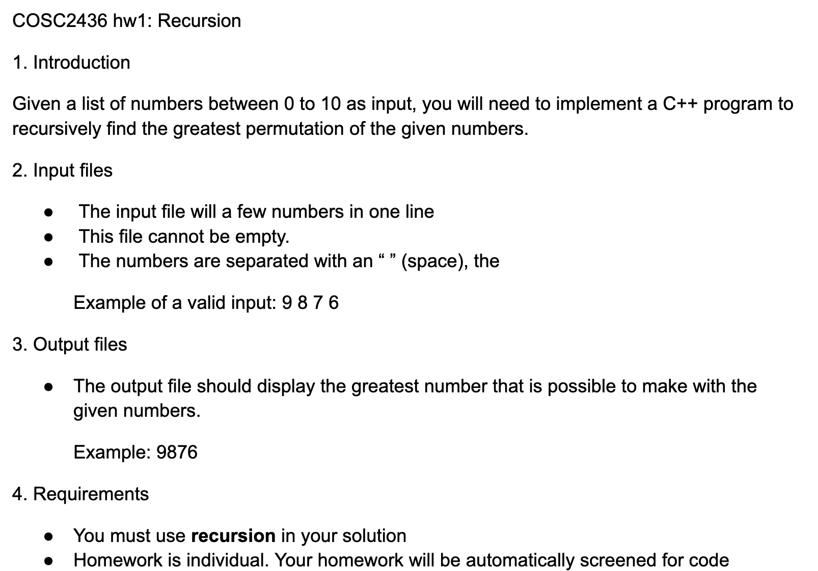
Homework 1
Remember what we covered last week over recursion…
Base Case
Recursive Call
Edge Cases
Will talk further about this
if we have the time in workshop

Slide 4
Pointers & Dynamic Memory

Slide 5
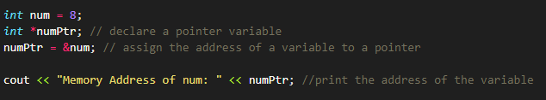
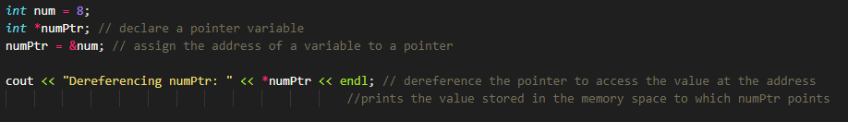
Quick Pointers Recap
Pointers - a variable that stores another variable’s memory address
Address Of (&) Operator
Returns address of operator
Dereference (*) Operator
Refers to the object to which the operand of the * points

Slide 6
Pointer Practice!
Consider the following statements:
Num = 78;
p = &num;
*p = 24;
Assume…
Memory location 1200 is allocated for p
Memory location 1800 is
allocated for num
. . .
. . .
. . .
1200
p
1800
num

Slide 7
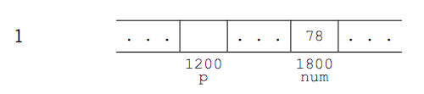

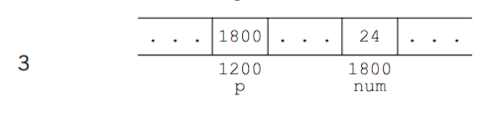
Solution

Slide 8

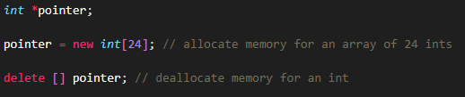
Dynamic Memory
Operator new
The operator new allocates memory (a variable) of the designated type and returns a pointer to it
Operator delete
When a dynamic variable is no longer needed, it can be destroyed; that is, its memory can be deallocated. The C++ operator delete is used to destroy dynamic variables, so that its memory space can be allocated again when needed.

Slide 9
Heaps Vs. Stacks
So far, all arrays we’ve worked with have been static arrays, arrays stored in stack memory!
Dynamically allocated arrays and their memory is allocated on heap memory!
Stack Memory
It allocates or de-allocates the memory automatically as soon as the corresponding method completes its execution.
Memory allocation and deallocation are faster as compared to Heap-memory allocation.
Used for temporary variables
Heap Memory
Programmers must manually allocate and deallocate memory (is NOT automatic)
Slower access compared to stack
The size of the Heap-memory is quite larger as compared to the Stack-memory.
Prone to memory leaks if not managed correctly

Slide 10
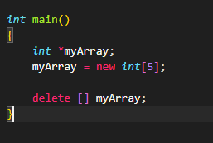
Dynamic Arrays
A disadvantage of using static arrays are their fixed size. There may be situations where we won’t know what a size of an array will be until we get a user input.
This is where dynamic arrays come in useful.

Slide 11
Dynamic Arrays Example
Write a program that takes in an integer then a string with that amount of characters and stores them in a dynamic array.
Your inputs are an int to get the size of the array then a name that gets stored in the array. YOU CANNOT USE STRING​
Hint: Use an array of characters!
*** Sample Code Provided on Teams ***

Slide 12
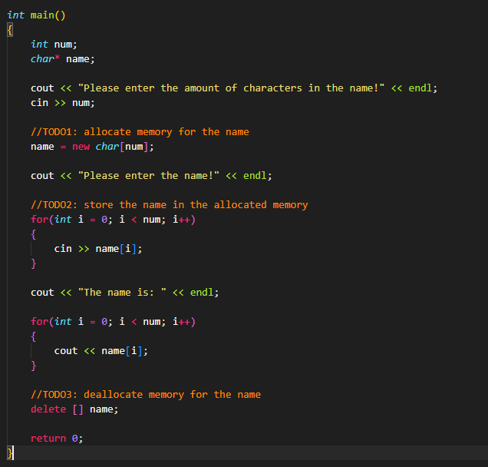
Solution

Slide 13
Something to Think About…
How would we resize a dynamic array?

Slide 14
Recursion (Cont’d)

Slide 15
Recap
Recursion occurs when a thing is defined in terms of itself or of its type.
Must for recursion function:
Base Case - condition to stop
Recursive Case - repetition of the function
Check for more edge cases
PLEASE COUT

Slide 16
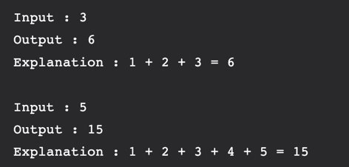
Recursive Sum
Given a number n, write a function that returns the sum of all numbers > 0 & < n​
You may assume n >= 0​
5 mins

Slide 17
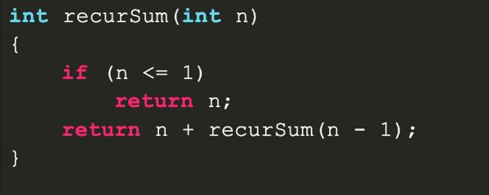
Solution
EASY

Slide 18
Reverse String
10 mins
Given an string = xyz, write a function that will return zyx.​
(modify the original array, DO NOT print in reverse)
string printRev(string s, int start, int end)
Remember swap using temp

Slide 19
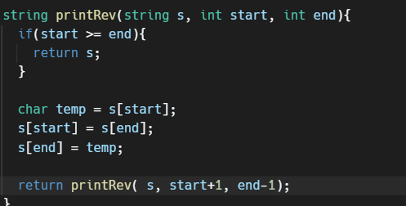
Solution

Slide 20
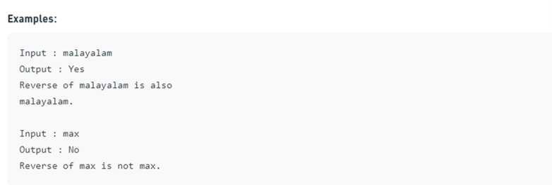
Palindrome
10 mins
Given a string, write a recursive function that checks if the string is a palindrome, otherwise, not a palindrome.​
Don't forget to test edge cases!​
One character and two-character strings
bool Palindrome(string s, int start, int end){

Slide 21
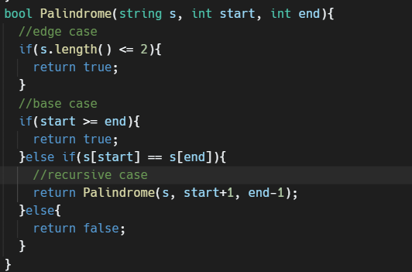
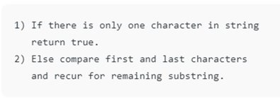
Solution

